Slide 1

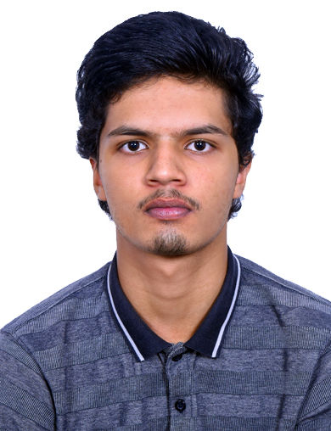
CGPA : 7.96
Number of Backlogs : 0
Career Interest of Student
Higher studies (M.Tech or MBA).
Data Analytics
AI/ML Engineering
Industry Mentor :
Internship Details
1. Machine Learning Intern – FlyRank AI (Ongoing)
SREEMSUN ANAND
DEPARTMENT OF COMPUTER SCIENCE AND ENGINEERING

